Slide 1

DATA3800 Data Science Project

Slide 2
BACKGROUND: Undiagnosed diabetes
In the last 20 years, the number of adults diagnosed with diabetes has more than doubled as the American population has aged and become more overweight or obese.
Type 2 diabetes accounts for approximately 90% to 95% of all diagnosed cases of diabetes in the US.
Around 38 million adults in the US have diabetes, and 1 in 5 of them don’t know they have it.
Around 96 million US adults have prediabetes, and more than 8 in 10 of them don’t know they have it.
(Source: Centers for Disease Control and Prevention.
https://www.cdc.gov/diabetes/basics/quick-facts.html. Accessed 07/10/2023)

Slide 3
THE PROBLEM
Untreated type 2 diabetes can lead to a number of serious complications including heart disease, stroke, blindness, kidney failure, limb amputation, and death.
Diabetes is the eighth leading cause of death in the United States.
Significant financial burden on patients (medical costs/lost wages).
The good news: Pre-diabetes is reversible!
With early detection and appropriate lifestyle changes.
Successfully identifying and treating pre-diabetics is key step in tackling the growing trend of diabetes in the US.
But how to reach this demographic if so many don’t know they have the condition?

Slide 4
THE RESEARCH QUESTION
Is it possible to accurately classify a person as being diabetic, pre-diabetic or non-diabetic based upon survey responses?
If so:
It might be possible to create a simple questionnaire-based tool that screens for diabetes without the need for clinical data.
Initial screening happens outside of clinical setting => time/cost/resource efficient.
Follow-up medical appointments only required for those positively identified as diabetic => avoids overwhelming medical practices.
More people diagnosed faster => fewer suffering long-term/serious complications.

Slide 5
THE DATA SET
The Behavioral Risk Factor Surveillance System (BRFSS) is an annual telephone survey conducted by the CDC that collects data on a wide array of health-related topics.
Cleaned and curated version available on Kaggle from original BRFSS data from 2015, which I expanded/adjusted based on my own interpretation of the survey documentation and understanding of diabetes risk factors.
245,352 observations – I used a random subset of 60,000 observations.
Number of features reduced from 330 to 24: 16 nominal features (13 binary), 5 ordinal features and 3 numerical features.
Unreliable target feature – many respondents likely to be unaware of their diabetic status.
Logistic regression would produce misleading results (no ground truth).
Alternative: drop the target feature and use unsupervised learning on unlabelled data.
Use clustering to try to find natural patterns in the data that would allow me to group respondents by diabetic status.

Slide 6
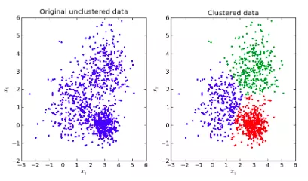
The DATA PIPELINE
CLUSTER
ANALYSIS
DATA SOURCE
BRFSS survey
CLUSTERING
K-Modes
Describing the characteristics of the clusters:
Cluster profiling
Feature importance
Cluster centroids
Do we have sufficient insight to be able to answer the research question?
Python/Jupyter:
Extraction
Exploration
Cleaning/preprocessing (datatype conversion, encoding)
Feature selection
Set hyperparameters
Run algorithm
Visualising the clusters
Evaluating cluster quality
Need well-defined clusters to continue

Slide 7
K-Modes clustering
Suitable for categorical data.
Centroids determined by mode value of each feature.
Hyperparameters affect how algorithm performs:
Number of clusters (determined by elbow method)
Initialisation (Cao by default)
Cluster quality evaluated using silhouette score (how similar each data point is to its own cluster compared to other clusters).
Which data to feed in?
“The problem of feature selection originates from the fact that while collecting data, one tends to collect all possible data. But for a specific learning task such as clustering not all the attributes or features are important. … Some of the features may be redundant, some are irrelevant, and others may be ‘weakly relevant’. The task of feature selection for clustering is to select ‘best’ set of relevant features that helps to uncover the natural clusters from data according to the chosen criterion.”
Dash, M. & Koot, P.W. (2009). Feature selection for clustering. In L. Liu & M.T. Özsu (Eds.), Encyclopedia of database systems. https://link.springer.com/referenceworkentry/10.1007/978-0-387-39940-9_613

Slide 8
FEATURE SELECTION
I tried three different approaches to find best set of most relevant features:
Perform Multiple Correspondence Analysis (MCA) on the entire data set
Dimensionality reduction technique – transforming original data into new set of independent vectors that simplify the relationships between the original features.
Vectors represent same information as original data set, but in a lower dimensional space.
Filter method using statistical analysis
Features with low variance add noise – do not contribute to the decision-making process.
Chi square test of independence/Phi_{k} coefficient can identify highly correlated features in categorical data that may cause redundancy and bias towards certain features.
Wrapper method using our own implementation of Sequential Backward Selection (SBS)
Starting with full data set, test effect of removing one feature at a time.
Improves the performance of the model incrementally.

Slide 9
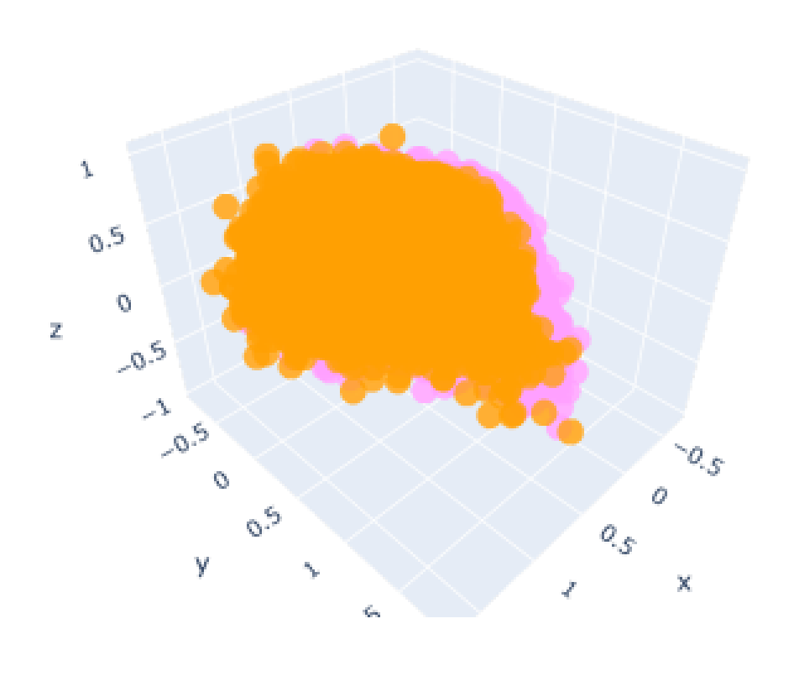
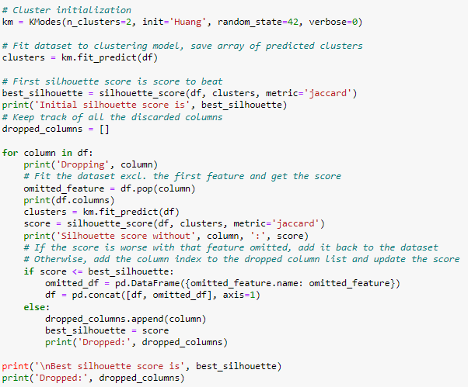
CLUster evaluation
Low silhouette score indicates poorly defined clusters with large degree of overlap
Silhouette score to evaluate quality of clusters
A score of >= 0.5 is considered to indicate reasonably good
clustering (Source: https://en.wikipedia.org/wiki/Silhouette_(clustering))
Method of feature selection | Silhouette score
Full data set | 0.132
Full data set with MCA | 0.161
Filter method | 0.124
Wrapper method (SBS) | 0.163
Score of 0.259 achieved with SBS with following changes:
Refined wrapper function
Huang initialisation
Jaccard distance

Slide 10
REFLECtions & Further work
Unable to answer the research question, but two important takeaways:
Every decision we make from selection of data set to setting hyperparameters heavily influences the quality of the clusters. Important to consider goal and plan ahead.
Cluster analysis is an essential component of the process – performance measure alone is not sufficient to draw meaningful conclusions about the clusters. Higher silhouette score ≠ closer to goal!
Clustering process involves so many variables, providing many avenues for further exploration:
Exploring different clustering algorithms
K-Prototypes for mixed data
DBSCAN, spectral clustering, neural networks can be adapted to work with categorical data
Try different methods of encoding categorical features (e.g. OHE for low cardinality features)
Look at other wrapper methods such as Recursive Feature Elimination or Feature Selection libraries
Finetuning hyperparameters (e.g. cluster initialization, distance metric/similarity measure)
Consider other evaluation metrics for assessing cluster quality (e.g. Davis-Bouldin Index)
After exhausting all these alternatives, we may have to consider that the chosen data set doesn’t meet our needs or that it’s simply not possible to determine diabetes from survey responses.

